Slide 1
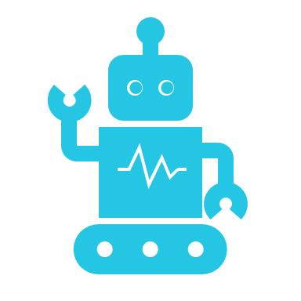
Create Intelligent Bots with the Azure Bot Service
By: Tariq Abubaker

Slide 2
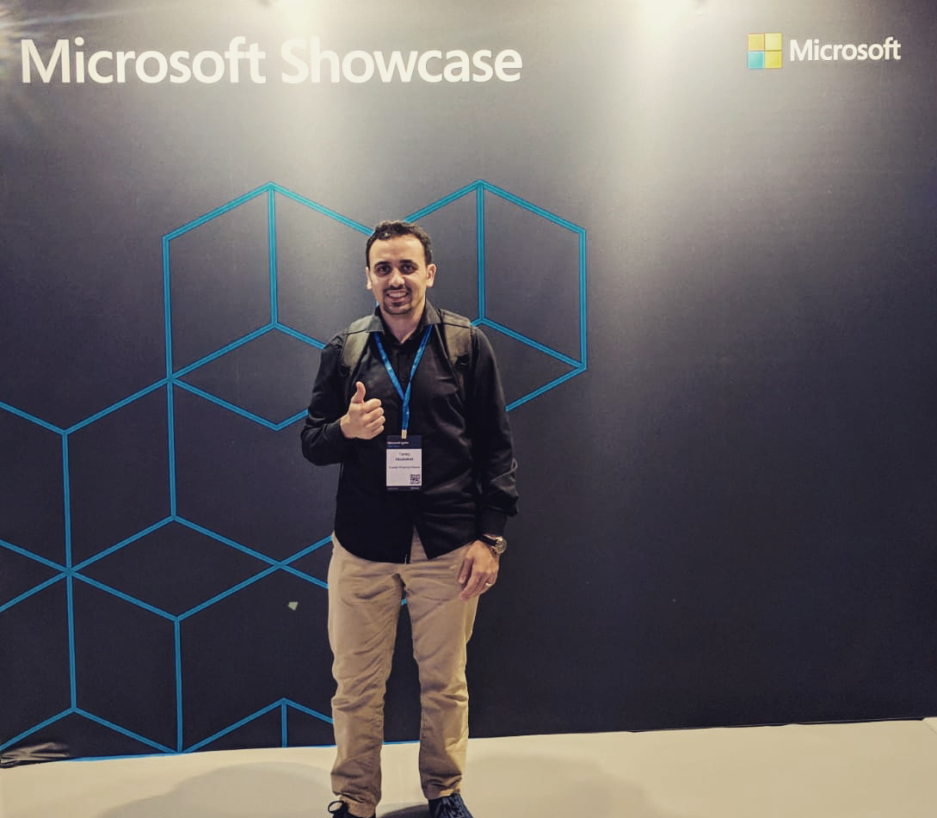


Tariq Abubaker
Overview
IT Enterprise Architect for Kuwait Finance House.
+10 years of experience in the IT and banking industry. I participated multiple projects range from SOA, EA, Core banking, Payment Solutions, Credit Cards, AML and Fraud, CRM, Retail, Finance, and IT service management solutions.
Certifications
TOGAF® 9 Certified.
Azure Certified.
DevOps Certified.
MCTS: .NET Framework 4, Web Applications.
MCP
Contact Details
https://www.linkedin.com/in/tariq-abubaker/
@taq_abubaker

Slide 3
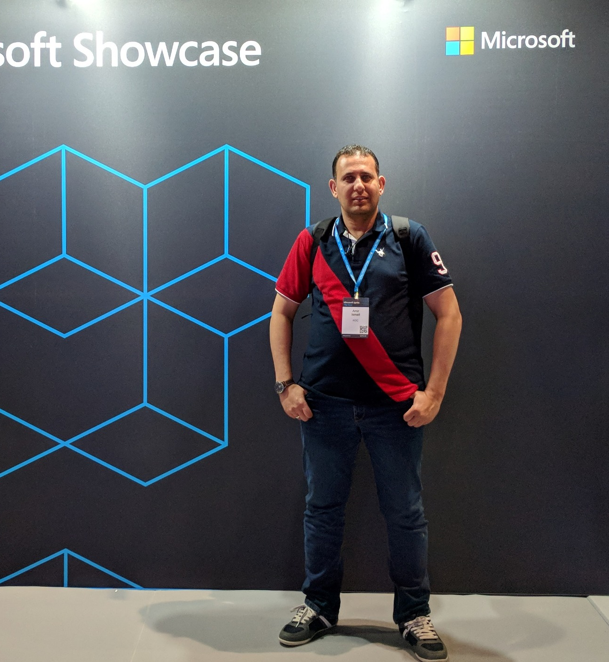
Amir Ismail
Overview
Senior Software Engineer for Kuwait Oil Company.
+15 years of experience in Software Engineering. I participated in multiple projects in different business domains range from E-learning, Banking, Oil, E-booing and Hotels management.
Certifications
PSM I Certified.
ITIL® Certified.
PRINCE2® Certified.
Contact Details
https://www.linkedin.com/in/amirismailyousef/

Slide 4
What is Bot?
Application that performs one or more automated tasks. Typically, bots perform tasks that are both simple and structurally repetitive, at a much higher rate than would be possible for a human alone.
Yes, just an application 😮
4

Slide 5
What is Chatbot?
Hi there!
An application that conducts a conversation via auditory or textual methods.
Chatbots are typically used in dialog systems for various practical purposes including customer service or information acquisition. Some chatbots use sophisticated natural language processing systems, but many simpler ones scan for keywords within the input, then pull a reply with the most matching keywords, or the most similar wording pattern, from a database.
5

Slide 6
The History of Chatbots
ELIZA
1966
PARRY
1972
JABBERWACKY
1988
DR. SBAITSO
1992
A.L.I.C.E.
1995
SMARTERCHILD 2001
IBM’S WATSON 2006
SIRI 2010
GOOGLE NOW 2012
ALEXA 2015
CORTANA 2015
BOTS FOR MESSANGER 2016
TAY 2016

Slide 7
Where you would find them
Act as agent for user
Translate user intent
Perform actions
Combine data from multiple sources
Maintain dialog context
May exhibit personality

Slide 8
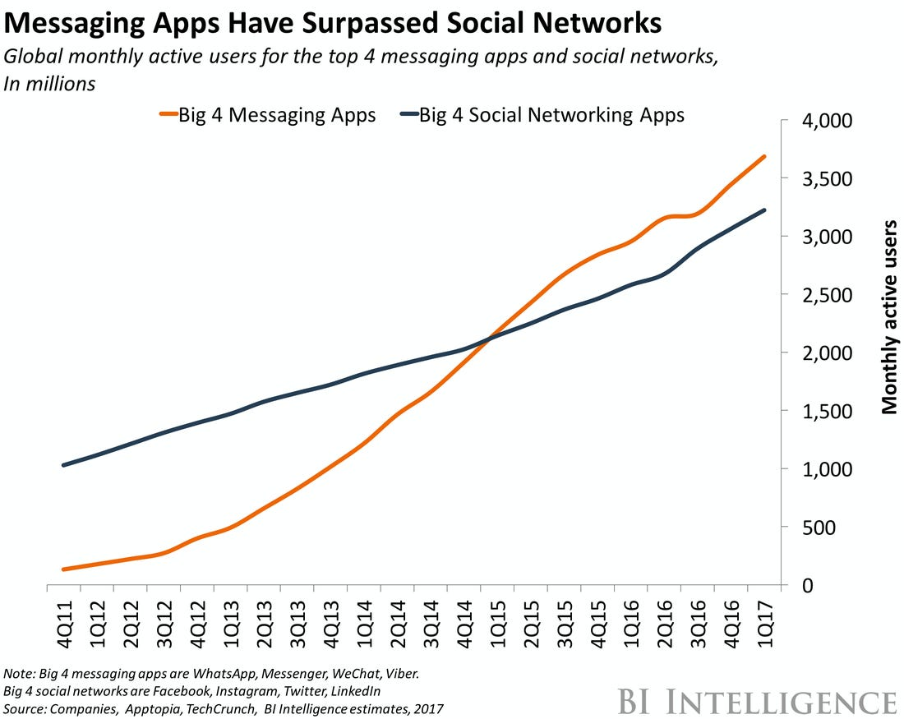
Why bother?
Messaging applications are dominating!
Q1 2015 the monthly active users of the top 4 messaging apps surpassed monthly active social network app users.

Slide 9
Why bother? - Forecasts
Business Insider experts predict that by 2020, 80% of enterprises will use chatbots.
According to Opus Research, by 2021, 4.5 billion dollars will be invested in chatbots.
According to Lauren Foye, by 2022, banks can automate up to 90% of their customer interaction using chatbots.
According to Adobe, 28% of leading companies use AI for marketing, while 31% plan to use AI in the next 12 months.
According to Drift, 27% of adult clients in the United States are ready to purchase basic goods through a chatbot, 13% of adults in the US have at least once bought expensive items using chatbots.

Slide 10
Additional Benefits
Engage with the chat-generation.
Lowered business cost to serve internally and externally.
Improved resource focus on other tasks.
More quickly connect users with information and services.
Act as a friendly navigator for legacy or cumbersome data.

Slide 11
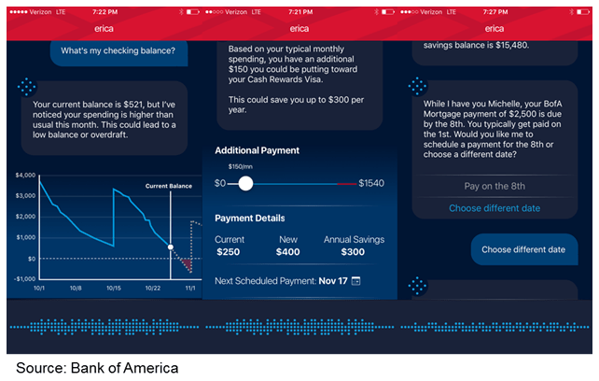
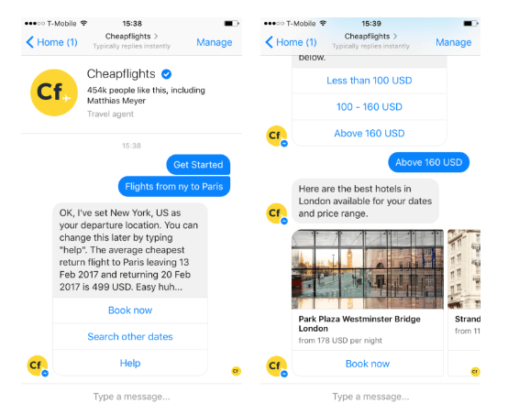
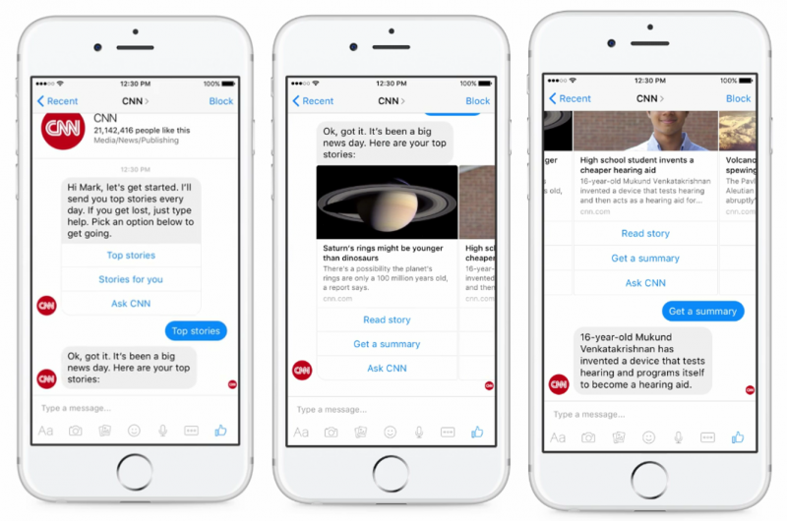
Examples

Slide 12




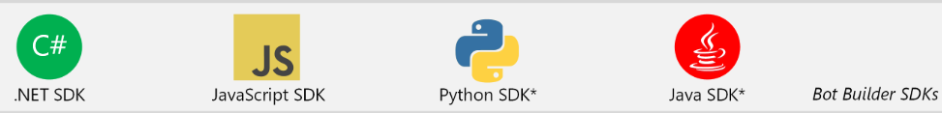


Azure Bot Service
Azure Bot Service provides an integrated environment that is purpose-built for bot development, enabling you to build, connect, test, deploy, and manage intelligent bots, all from one place.
Azure Bot Service leverages the Bot Framework SDK with support for C#, JavaScript, Python, and Java.
Customer’s
business logic and data
Bot connector
C#
BOT BUILDER
Bot Controls
Skype
Bing
WebChat
LUIS
Form Filling
QnA
Skype for Business
Cortana
Direct Line
Query over database via Azure Search
Third-party

Slide 13
Azure Bot Service and Bot Framework offer
Bot Framework SDK for developing bots
Bot Framework Tools to cover end-to-end bot development workflow
Bot Framework Service (BFS) to send and receive messages and events between bots and channels
Bot deployment and channel configuration in Azure

Slide 14
Enrich your bot by using Azure Cognitive Services
Language A machine learning-based service to build natural language experiences. Quickly create enterprise-ready, custom models that continuously improve
QnA Maker Publish a simple question and answer bot based on existing FAQ URLs, structured documents and product manuals
Speech Hear commands, identify individual speakers, translate, and reply to customers in natural language with a branded voice
Search Search across defined domains or the web for customer data, inventory status, research results, transaction records and more
Vision Recognize faces, moderate content, and index images and video with computer vision services

Slide 15
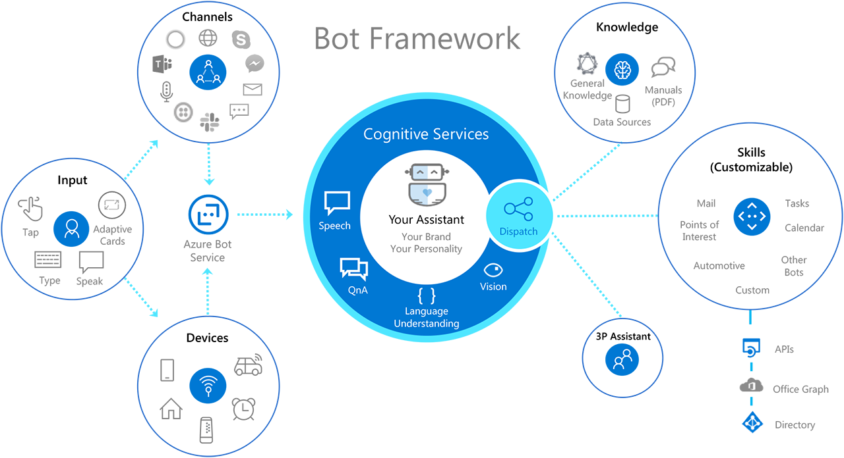
Components of a conversational AI experience
What we are going to implement

Slide 16
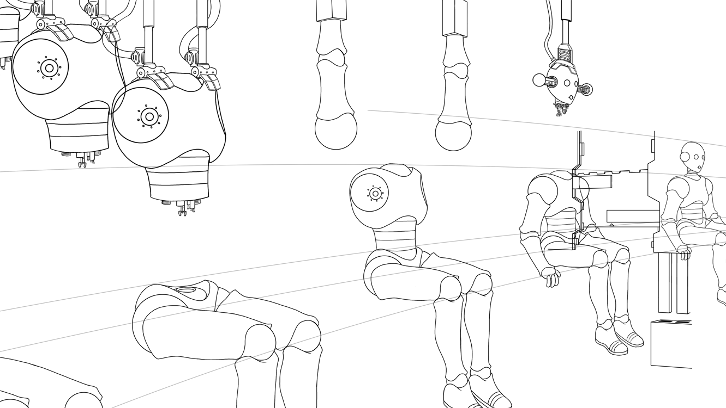
Demo

Slide 17
What is the QnA Maker service?
QnA Maker is a cloud-based Natural Language Processing (NLP) service that easily creates a natural conversational layer over your data. It can be used to find the most appropriate answer for any given natural language input, from your custom knowledge base (KB) of information.

Slide 18
When to use QnA Maker?
When you have static information.
When you want to provide the same answer to a request, question, or command.
When you want to filter static information based on meta-information.
When you want to manage a bot conversation that includes static information.

Slide 19
Demo

Slide 20
What is LUIS?
Language Understanding Intelligence Service (LUIS) is a cloud-based API service that applies custom machine-learning intelligence to natural language text to predict overall meaning, and pull out relevant, detailed information.

Slide 21
LUIS
LUIS deals with Intents & Entities.
Trained with a number of Utterances for each intent with entity placement.
Determines with a degree of confidence which intent was meant from a given phrase.
Provides the Intent and extracted entities to application.
Developer can see stats on intents selected by LUIS over time and can guide the training based on actual user utterances.

Slide 22
Demo

Slide 23


Contact Us
@azure_q8
@azure_q8

Slide 24
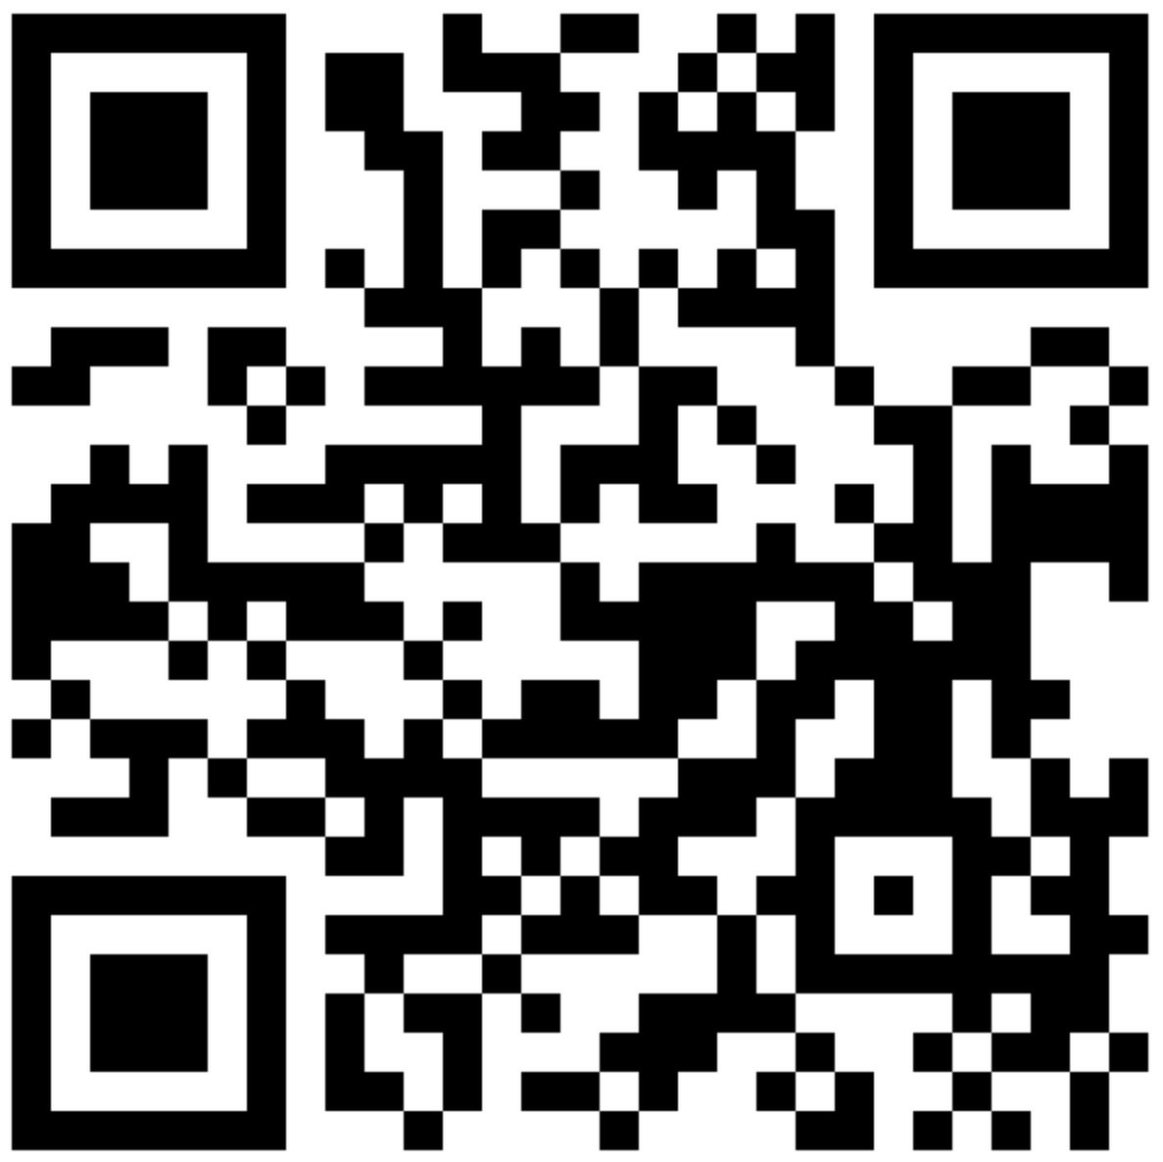
SCAN THE CODE & START YOUR Migration today
https://aka.ms/AA6923d
24

Slide 25
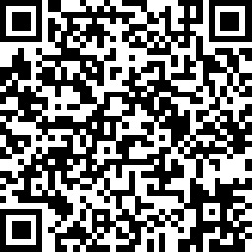
SCAN THE CODE & SEND US YOUR FEEDBACK!
https://www.surveymonkey.com/r/DQ8GS59
25

Slide 26
Resources
https://docs.microsoft.com/en-us/azure/bot-service/?view=azure-bot-service-4.0
https://docs.microsoft.com/en-us/azure/cognitive-services/qnamaker/overview/overview
https://docs.microsoft.com/en-us/azure/cognitive-services/luis/what-is-luis
https://dev.botframework.com/
https://chatbotsmagazine.com/chatbot-report-2019-global-trends-and-analysis-a487afec05b
https://www.techmeet360.com/techtalksession/AzureBotFramework.pptx

Slide 27
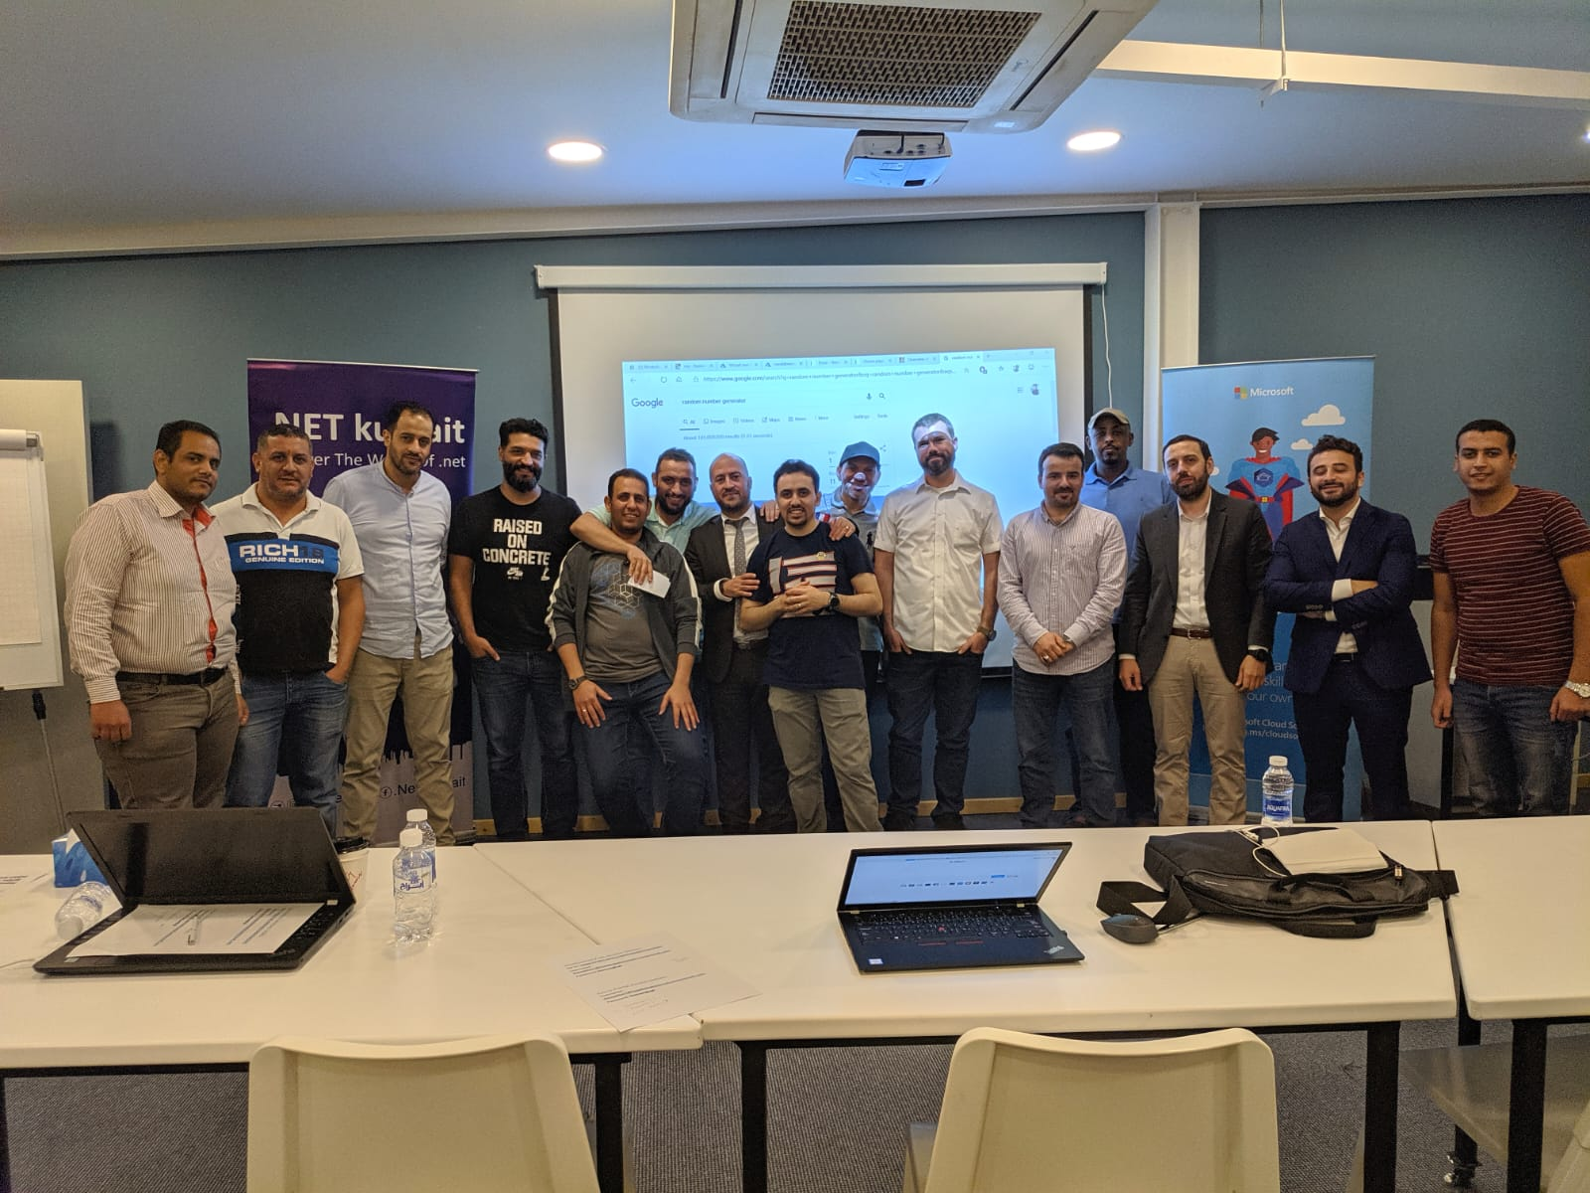

Thank You!
Let’s have another group photo

